Slide 1
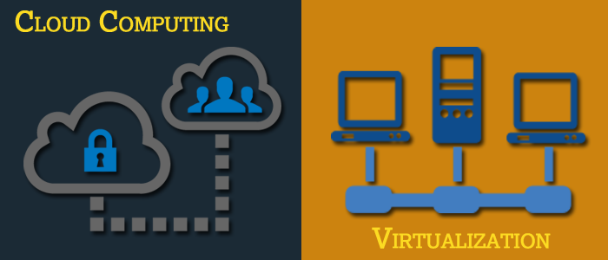
Basics of Virtualization and Cloud Technology

Slide 2
Chapter 4: Introduction to Virtual Hard Disk and Hypervisor Management Application

Slide 3
Introduction to VHD and Hypervisor Management Application
Why VHD?
What is VHD?
What is Hypervisor?
Different Types of Hypervisor Management
Application

Slide 4
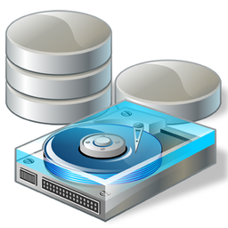
Why VHD?
A Virtual Hard Disk (VHD) allows multiple operating systems to reside on a single host machine. This method enables developers to test software on different operating systems without the cost or hassle of installing a second hard disk or partitioning a single hard disk into multiple volumes.
One of the reason why virtual machines are so great is because virtual hard disks (VHDs) are so flexible. Compared to their physical counterparts, VHDs can be created in, added to and removed from a virtual machine (VM) quickly and easily. VHDs also support various configurations that can allow to use physical disk space efficiently.
Source: http://www.shaplus.com/guide/Computer_Internet/virtualpc-run-multiple-operating-systems.htm

Slide 5
What is VHD?
A virtual hard disk provides storage for a virtual machine. Within a virtual machine, the virtual hard disk is represented as a physical disk and is used by the virtual machine as if it were a physical disk.
Technically, the virtual hard disk is a file that resides on a physical disk that the host operating system can access. On the physical disk, the virtual hard disk file is stored as a .vhd file. As a general rule, you can store a .vhd file on any type of storage device as long as the host operating system can access the storage device.
Virtual hard disks are of two types:
Fixed size
Dynamically expanding
Source: https://technet.microsoft.com/en-us/library/cc708315(v=ws.10).aspx
Notes:
Both types have a maximum size value that specifies how large the disk will appear to virtual machines that are hosted within Virtual Server. However, fixed-size VHDs will automatically take up physical disk space on the host computer's file system, whereas dynamically expanding disks will allocate space only as needed. Overall, the dynamic option is easier to manage (especially if you are limited by available physical disk space), but the fixed-size option can offer the best performance (by avoiding overhead and fragmentation related to growing files).

Slide 6
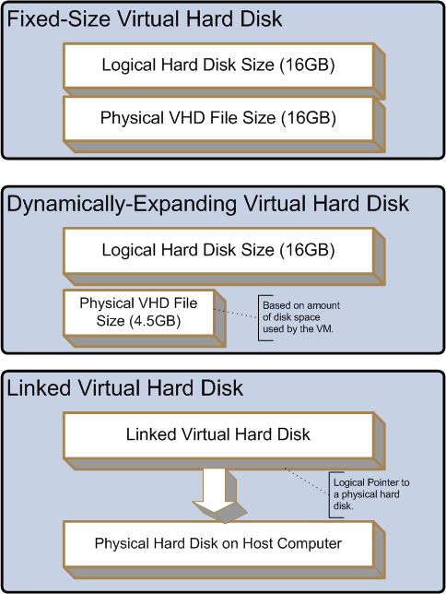
Linked Hard Disk
Linked hard disks map to a single physical hard disk on the host computer. This type of hard disk is created primarily for converting a physical hard disk into a VHD. First, you create the linked VHD and then you convert it to a fixed-size or dynamically expanding VHD. Beware that if you make a linked hard disk accessible to a virtual machine, the VM can change data stored on the host's physical hard disk. The figure shows the comparison of three different types of VHDs.
Source: http://searchservervirtualization.techtarget.com/tip/Understanding-VHD-virtual-hard-disk-options
Comparing the Three Different VHDs
Notes:
One advantage of working with virtual machines is the ability to rollback a VM to its previous state. In Virtual Server, you can accomplish this by enabling undo disks. When you check this box, Virtual Server will automatically create a .vhd file for each of the VHDs that are attached to the VM. This will effectively make the .vhd files read-only and all write operations will be performed to the undo files. When you choose to power off a VM, you can keep the undo disks, commit the changes (which updates the base VHD files) or discard the changes (which effectively rolls a VM back to its state before undo disks were enabled).

Slide 7
VHD Architecture in Virtualized Environment
A virtual hard disk (VHD) is a file that encapsulates a hard disk image. VHDs can be used in new and interesting ways. VHDs first were created to be the storage media for virtual machines (VMs). Today, VHDs are used to ship trial versions of software, used in backup solutions, used for bug triage (for example, customers can convert a physical disk to virtual and share it) and even used to store multiple boot environments. VHDs are very flexible storage containers and are not tied to any single file system format.
Microsoft began using VHD technology in Microsoft Virtual PC around 2003, and then continued its use in Microsoft Virtual Server release in 2005. The next major release happened as part of Hyper-V in Windows Server 2008. Currently VHD support is made as part of Windows Server 2008 R2 .
VHDs were limited to use by virtual machines running in Virtual PC/Virtual Server/Hyper-V and loopback mounting of VHDs in the parent partition sometimes referred to as the management operating system. The integration of VHD support into the operating system was drastically improved in Windows Server 2008 R2 which added native support.
There are three VHD formats each with different performance characteristics. The three formats of VHD are fixed, dynamic and differencing.
Source: https://blogs.technet.microsoft.com/ranjanajain/2010/03/23/virtual-hard-disk-vhd-architecture-explained/

Slide 8
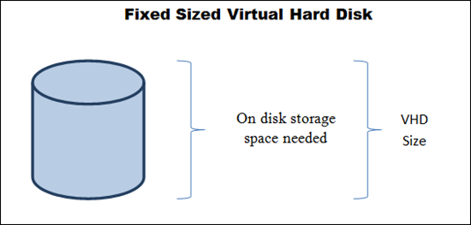
Fixed Size Virtual Hard Disk
A fixed sized VHD uses a file in which the space to store the file is allocated on the physical storage when the virtual hard disk is created.
The file size is the same as the size specified for the virtual hard disk. As their name implies, fixed sized VHDs occupy the same space on the underlying physical storage device as their specified size. However, once a fixed sized VHD is created, the size can be increased when the disk is offline by editing the disk to expand it.
Reducing the size is not supported. Because the physical storage required for a fixed size VHD is allocated when the VHD is created, there is a better chance at optimal placement and organisation on-disk which yields the best performance.
The disadvantage is that the space is committed even if it is not used.
Source: https://blogs.technet.microsoft.com/ranjanajain/2010/03/23/virtual-hard-disk-vhd-architecture-explained/

Slide 9
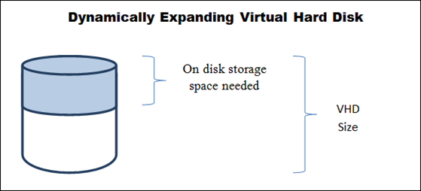
Dynamically Expanding Virtual Hard Disk
A dynamically expanding VHD is a file that at any given time is as large as the actual data written to it plus the size of on-disk meta-data. Dynamically expanding disks are useful because they do not require all the storage needed to contain the maximum size of the disk to be reserved up front.
The VHD file starts quite small (for example, 42KB is a typical physical size of an empty 20GB disk) and grows as new blocks in the disk are used.
There are a number of optimizations around dynamically expanding disks that improve performance; however, in general their read/write performance is slower than fixed disks.
One optimization is the selection of data block size which can be either 512KB or 2MB; another is skipping allocation of all-zero blocks.
Source: https://blogs.technet.microsoft.com/ranjanajain/2010/03/23/virtual-hard-disk-vhd-architecture-explained/

Slide 10
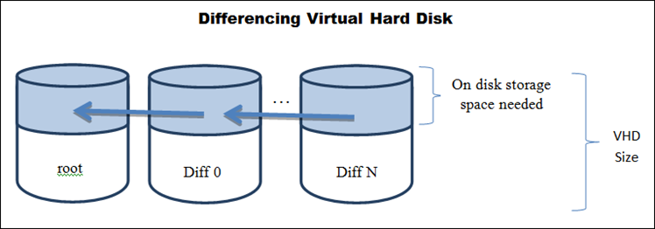
Differencing Virtual Hard Disk
A differencing VHD is a file representing the current state of the virtual hard disk as a set of modified blocks in comparison to a parent virtual hard disk. Differencing VHDs can be associated with either a fixed sized or dynamically expanding VHD.
Differencing VHDs can also be associated with another differencing VHD but they cannot be associated with a physical disk. Differencing VHDs are used to prevent changes from being made in their parent VHD to which they are applied and are used to implement a number of additional features.
In Hyper-V, differencing VHDs are also created automatically whenever snapshots are taken of a virtual machine. Note that differencing VHDs used for snapshot purpose are named with an AVHD file extension to help users easily distinguish them from regular differencing VHDs. Differencing VHDs may also be used to deploy a “golden” or “master” image, because one can associate multiple differencing VHDs to one parent VHD.
Some disadvantages of differencing VHDs are increased caching needs and the inability to grow or shrink the VHD size. You can however compact differencing VHDs to reclaim physical space usage.

Slide 11
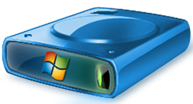
Features of VHD
There are following smart features, which are provided by virtual hard disks to make life simple and easy for enterprise computer users :
Ease in Sharing Files on Virtual Machine:
With help of the server, users can easily share or distribute their file over a network, which will allow everyone to access that file within a network.
Ease in Storing Backup File and its Recovery: Users can create a backup file of their system and then save it on a virtual machine. This will enable users to safely keep the replica of their files on local machine itself.

Slide 12
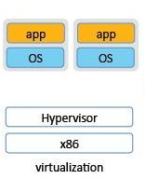
What is Hypervisor?
A hypervisor is a program that would enable you to host several different virtual machines on a single hardware. Each one of these virtual machines or operating systems you have will be able to run its own programs, as it will appear that the system has the host hardware's processor, memory and resources.
In reality, however, it is actually the hypervisor that is allocating those resources to the virtual machines.
Source: https://www.pluralsight.com/blog/it-ops/what-is-hypervisor

Slide 13
What does a hypervisor do?
A hypervisor is one of two main ways to virtualize a computing environment. By ‘virtualize’, we mean to divide the resources (CPU, RAM and others) of the physical computing environment (known as a host) into several smaller independent ‘virtual machines’ known as guests.
Each guest can run its own operating system, to which it appears the virtual machine has its own CPU and RAM, that is, it appears as if it has its own physical machine even though it does not. To do this efficiently, it requires support from the underlying processor (a feature called VT-x on Intel, and AMD-V on AMD).
One of the key functions a hypervisor provides is isolation, meaning that a guest cannot affect the operation of the host or any other guest, even if it crashes.
As such, the hypervisor must carefully emulate the hardware of a physical machine, and (except under carefully controlled circumstances), prevent access by a guest to the real hardware; how the hypervisor does this is a key determinant of virtual machine performance. But because emulating real hardware can be slow, hypervisors often provide special drivers, so called ‘paravirtualized drivers’ or ‘PV drivers’, such that virtual disks and network cards can be represented to the guest as if they were a new piece of hardware, using an interface optimized for the hypervisor.
These PV drivers are operating system and (often) hypervisor specific. Use of PV drivers can speed up performance by an order of magnitude and are also a key determinant to performance.
Source: https://www.pluralsight.com/blog/it-ops/what-is-hypervisor

Slide 14
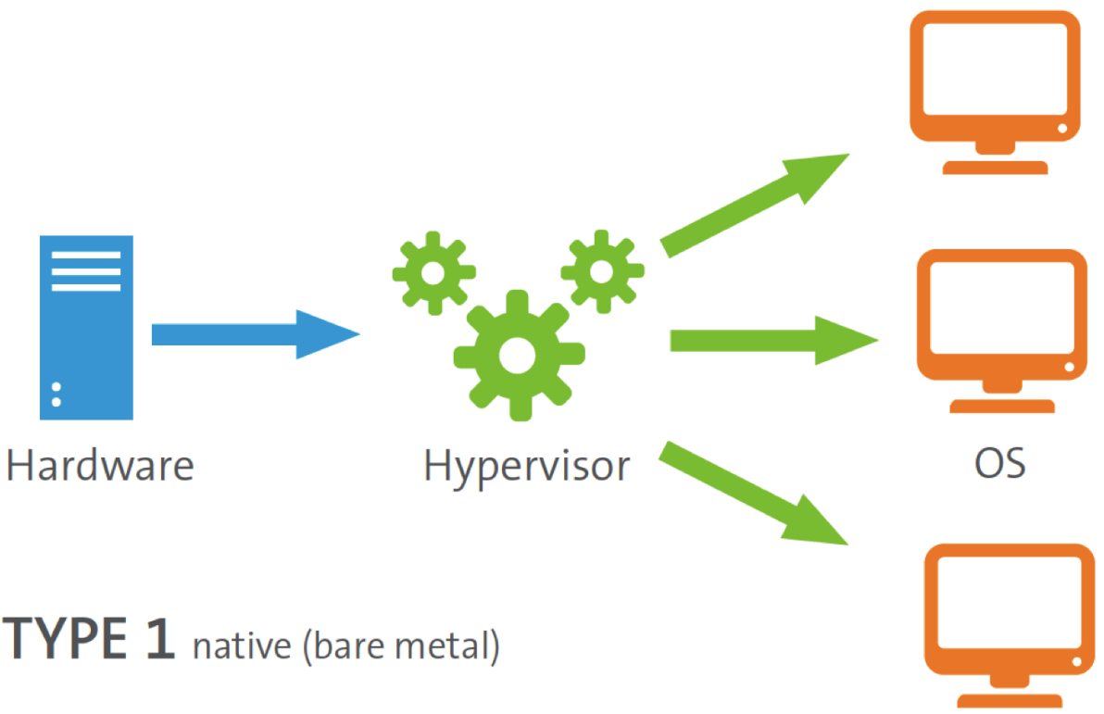
Different Types of Hypervisor Management Application
Hypervisors are often divided between Type 1 and Type 2 hypervisors.
Type 1 Hypervisor
A Type 1 hypervisor (sometimes called a ‘Bare Metal’ hypervisor) runs directly on top of the physical hardware. Each guest operating system runs on top of the hypervisor. Xen is perhaps the canonical example.

Slide 15

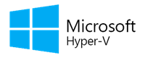
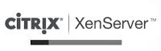
Type 1 Hypervisor Examples:
VMware ESX and ESXi:
Microsoft Hyper-V
Citrix XenServer
Notes:
VMware ESX and ESXi: These hypervisors offer advanced features and scalability, but require licensing, so the costs are higher. There are some lower-cost bundles that VMware offers and they can make hypervisor technology more affordable for small infrastructures. VMware is the leader in the Type-1 hypervisors. Their vSphere/ESXi product is available in a free edition and 5 commercial editions.
Microsoft Hyper-V: The Microsoft hypervisor, Hyper-V doesn’t offer many of the advanced features that VMware’s products provide. However, with XenServer and vSphere, Hyper-V is one of the top 3 Type-1 hypervisors. It was first released with Windows Server, but now Hyper-V has been greatly enhanced with Windows Server 2012 Hyper-V. Hyper-V is available in both, a free edition (with no GUI and no virtualization rights) and 4 commercial editions — Foundations (OEM only), Essentials, Standard, Datacentre and Hyper-V.
Citrix XenServer: It began as an open source project. The core hypervisor technology is free, but like VMware’s free ESXi, it has almost no advanced features. Xen is a type-1 bare-metal hypervisor. Just as Red Hat Enterprise Virtualization uses KVM, Citrix uses Xen in the commercial XenServer. Today, the Xen open source projects and community are at Xen.org. XenServer is a commercial type-1 hypervisor solution from Citrix, offered in 4 editions. Confusingly, Citrix has also branded their other proprietary solutions like XenApp and XenDesktop with the Xen name.

Slide 16
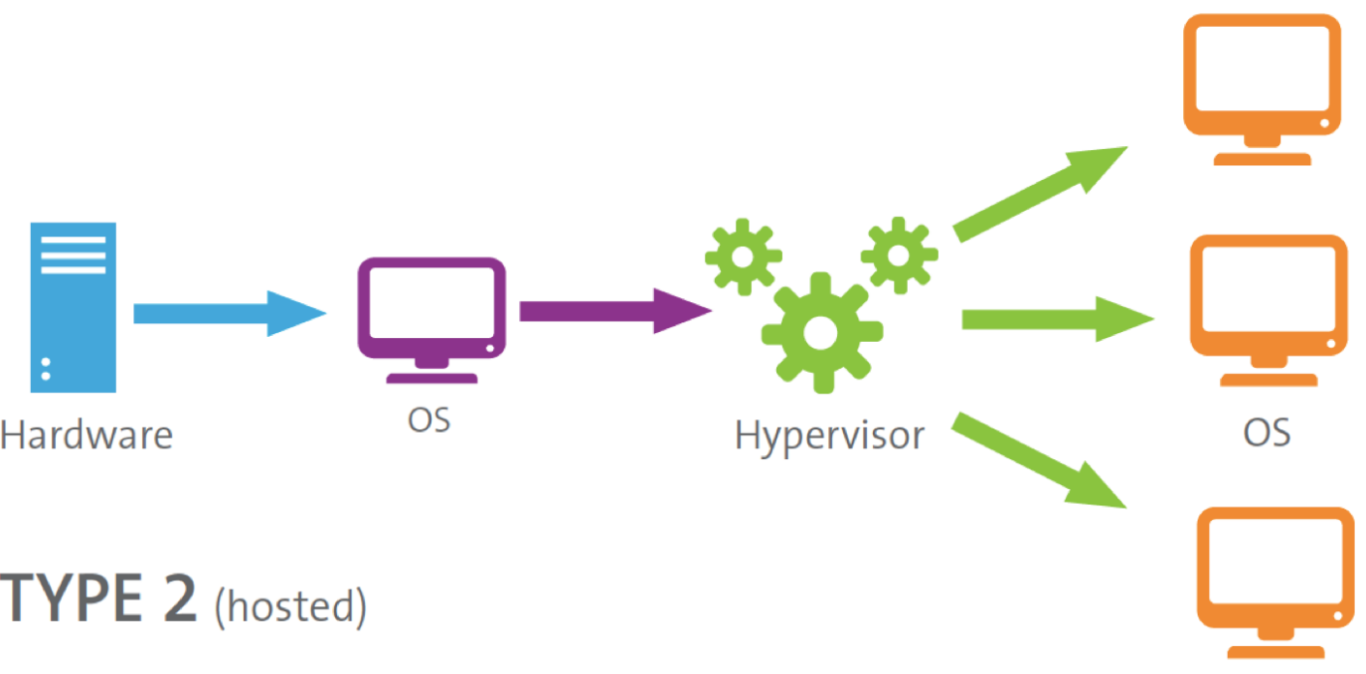
Type 2 Hypervisor
A Type 2 hypervisor (sometimes called a ‘Hosted’ hypervisor) runs inside an operating system which in turn runs on the physical hardware. Each guest operating system then runs atop the hypervisor. Desktop virtualization systems often work in this manner.

Slide 17
Examples of Type 2 hypervisor
VMware Workstation/Fusion/Player: VMware Player is a free virtualization hypervisor. It is intended to run only one virtual machine (VM) and does not allow creating VMs. VMware Workstation is a more robust hypervisor with some advanced features, such as, record-and-replay and VM snapshot support.
VMware Workstation has three major use cases:
For running multiple different operating systems or versions of one OS on one desktop
For developers that need sandbox environments and snapshots
For labs and demonstration purposes
Microsoft Virtual PC
Oracle VM
VirtualBox
Red Hat Enterprise Virtualization
Notes:
Microsoft Virtual PC: This is the latest Microsoft’s version of this hypervisor technology, Windows Virtual PC and runs only on Windows 7 and supports only Windows operating systems running on it.
Oracle VM VirtualBox: VirtualBox hypervisor technology provides reasonable performance and features if you want to virtualize on a budget. Despite being a free, hosted product with a very small footprint, VirtualBox shares many features with VMware vSphere and Microsoft Hyper-V.
Red Hat Enterprise Virtualization: Red Hat’s Kernel-based Virtual Machine (KVM) has qualities of both a hosted and a bare-metal virtualization hypervisor. It can turn the Linux kernel itself into a hypervisor, so the VMs have direct access to the physical hardware.

Slide 18


